Slide 1
Understanding Memory and your Brain

Slide 2
Grey matter
Your brain is not all grey matter
The grey matter is on the outside
The grey matter is specialised
A brain scan can show the size of different areas of grey matter

Slide 3
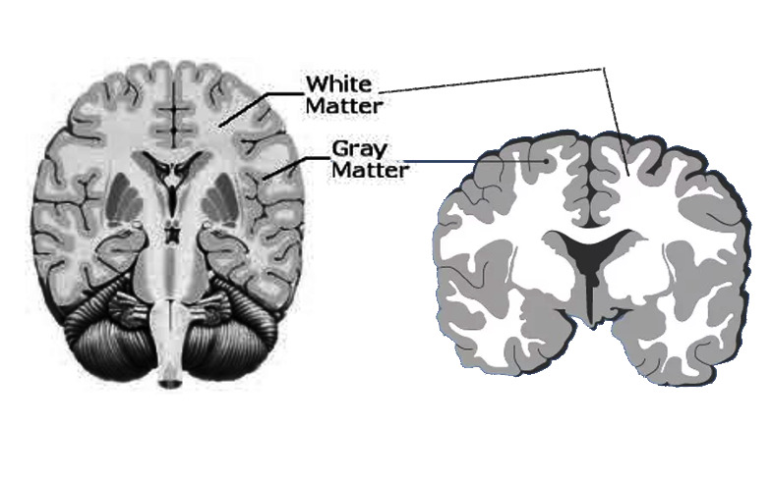

Slide 4
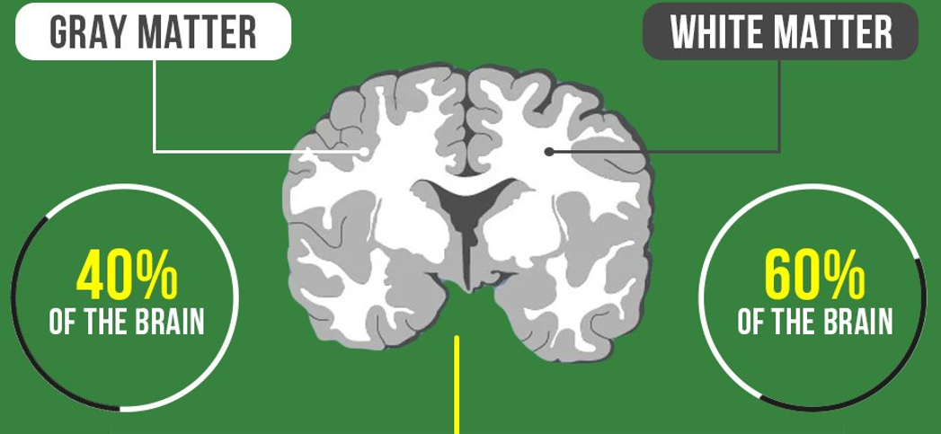

Slide 5
White matter
Areas of grey matter need to talk to each other, they are wired together
The “wiring” is made of long brain cells, and they are coated in fatty tissue
The fatty tissue makes the wiring look white – it is called white matter

Slide 6
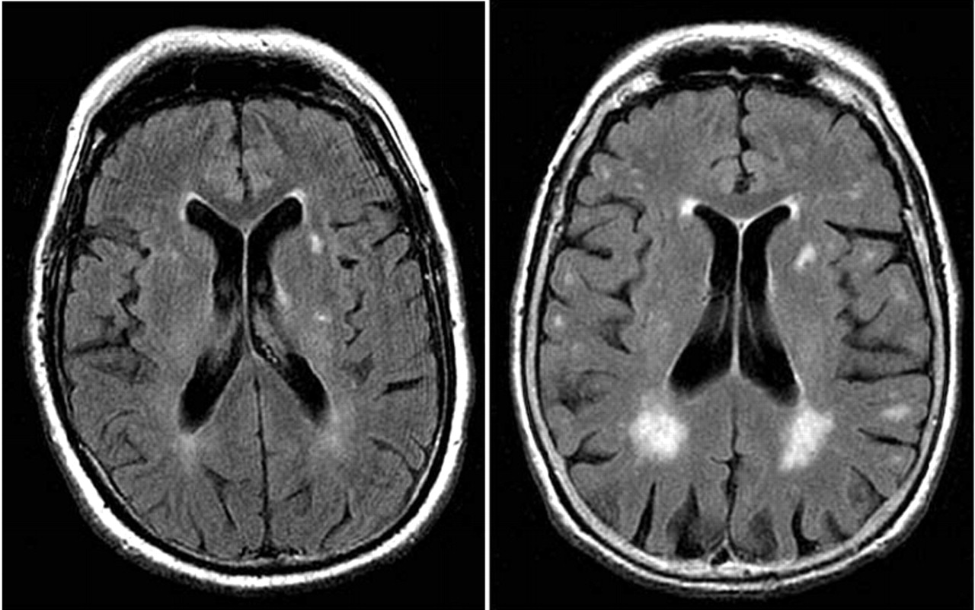
White matter is damaged by slow blood flow

Slide 7
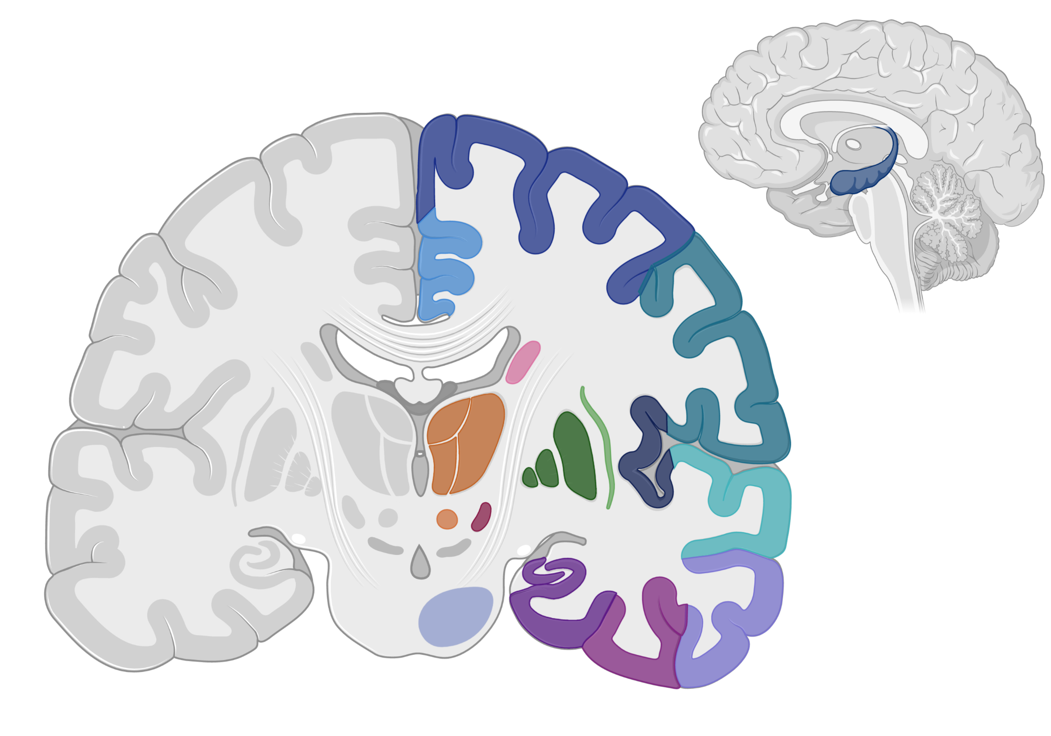
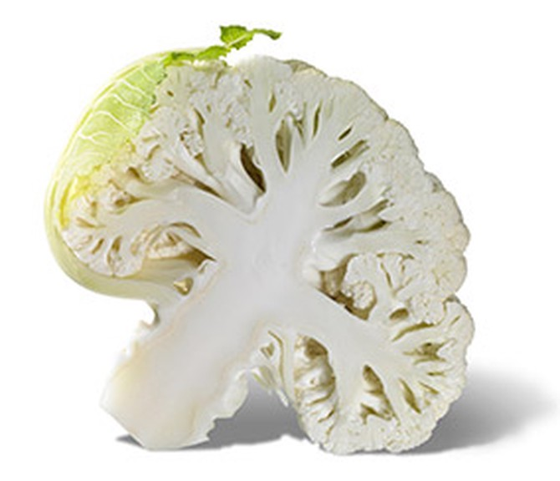
Hippocampus

Slide 8

Hippocampus

Slide 9
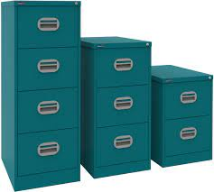
What is the job of the hippocampus?
The brain’s filing cabinets
Store new information
Recall previously learned information
Things are stored thematically (like is stored with like)

Slide 10
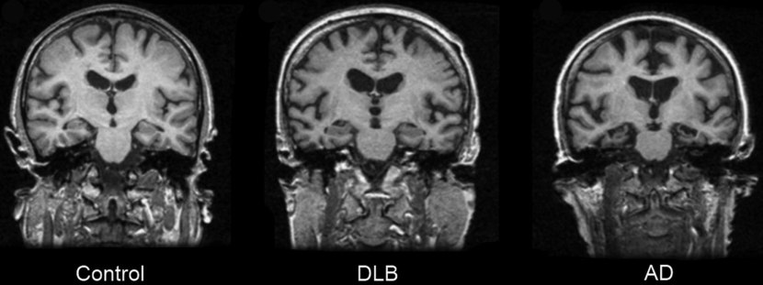
The progress of Alzheimer disease

Slide 11
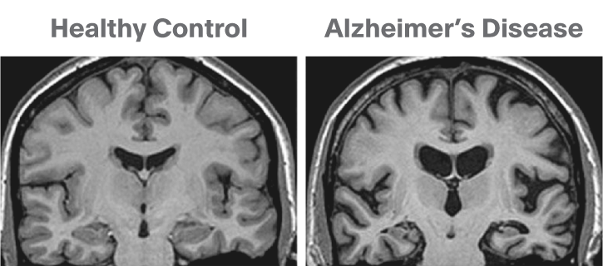

Slide 12
Hippocampus not the only area affected by AD
The first areas affected may show signs – under the microscope – 20 years before
Some areas affecting sleep
Some areas affecting mood

Slide 13
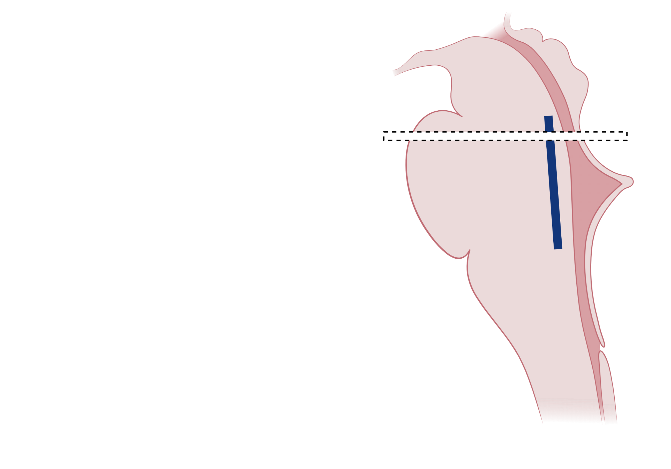
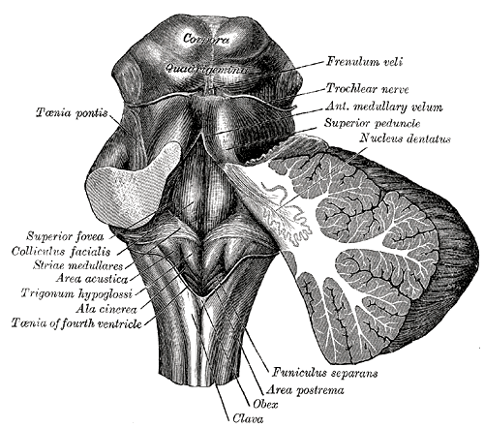
Locus Coeruleus
(The blue bit)
Pons

